Slide 1
Trade Monitoring ...A place for Marketing and Innovation
By
Group-8
Ashok Yaganti (68)
Yatheeswara Reddy Pulicherla (52)
Mohamed Gharibi (23)
Venkata Sasidhar Kanumuri (35)

Slide 2
Introduction
Trade Monitoring is an application service for the people to exchange their products i.e. buying and selling shares online. The main purpose of this online service is to facilitate the exchange of shares between buyers and sellers
Shares: Shares are small pieces of a company. Buying shares make you own small parts in that company
In our application we are going to create applications which provide a private service between buyers and sellers. Buyers can buy the company shares and if they wish to sell, they can sell with the current market value.

Slide 3
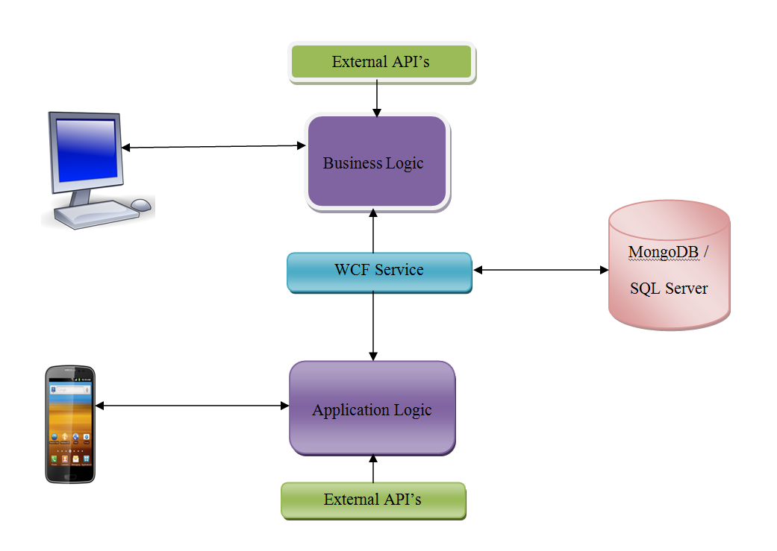
System Architecture

Slide 4
Features in our Application
Web Application:
Placing the order to buy the shares under condition
Displaying the User bought shares by user Portfolio
Sell the shares
Make Appointment
Generating reports and sending the Email notifications on every transaction.
Displaying the current trading information
Displaying the historical information from 1962.
Consuming WCF service.
Importing external API’s.
Mobile Application:
Buying and selling the shares.
Displaying the user portfolio.
Displaying the current trading information
Using WCF services from web application.
Importing external API’s

Slide 5
Technologies used in our Application
Web Application:
Front end: HTML, CSS, HTML5, Jquery, Java Script, Angular JS, Bootstrapping, ASP.Net
Back end: C#
Database: Mongo DB and SQL Server 2008.
Service: WCF
Tools: Visual studio 2010.
Mobile Application:
Front end: HTML5, Angular JS.
Back end: Backend Service with Angular JS
Database: Mongo DB.
Tools: Ionic Framework.

Slide 6
External services
http://ichart.finance.yahoo.com/table.csv?s={0}&c={1}
http://finance.yahoo.com/d/quotes.csv?s=AAPL+ACH+BAB+DAL+DWSN+EXPE+FCF+GYRO+HFWA+INFY+LAKE+NATI+OFC+PCTY+SAND+VTA+WPPGY+XL V+YHOO+YUM&f=snbaopl1
http://download.finance.yahoo.com/d/quotes.csv?s
http://download.finance.yahoo.com/d/quotes.csv?s="+symbol+"&f=sl1d1t1c1hgvbap2
http://ichart.finance.yahoo.com/w?s=" + symbol + "&" + rand_no
https://maps.googleapis.com/maps/api/js?v=3.exp&sensor=false
http://chart.apis.google.com/chart?chst=d_map_pin_letter&chld=%E2%80%A2 |
http://chart.apis.google.com/chart?chst=d_map_pin_shadow

Slide 7
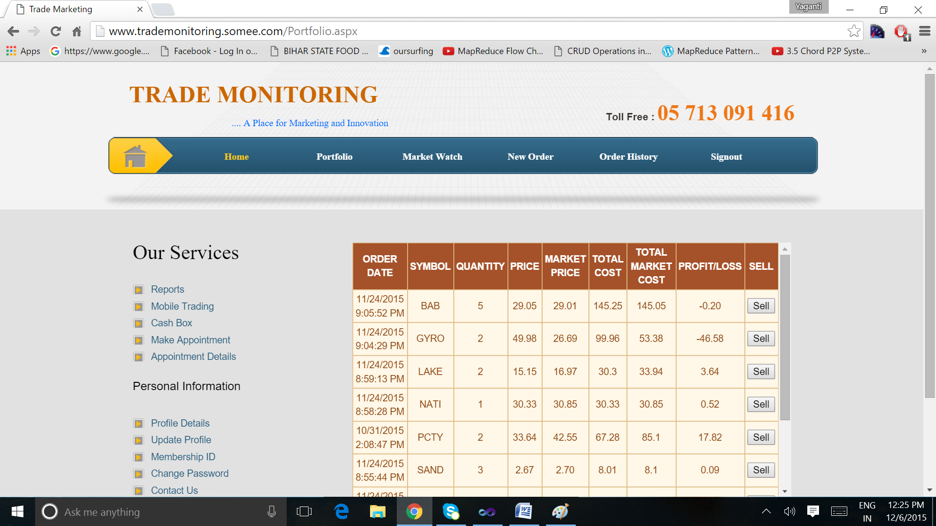
Implementation Results User Portfolio :

Slide 8
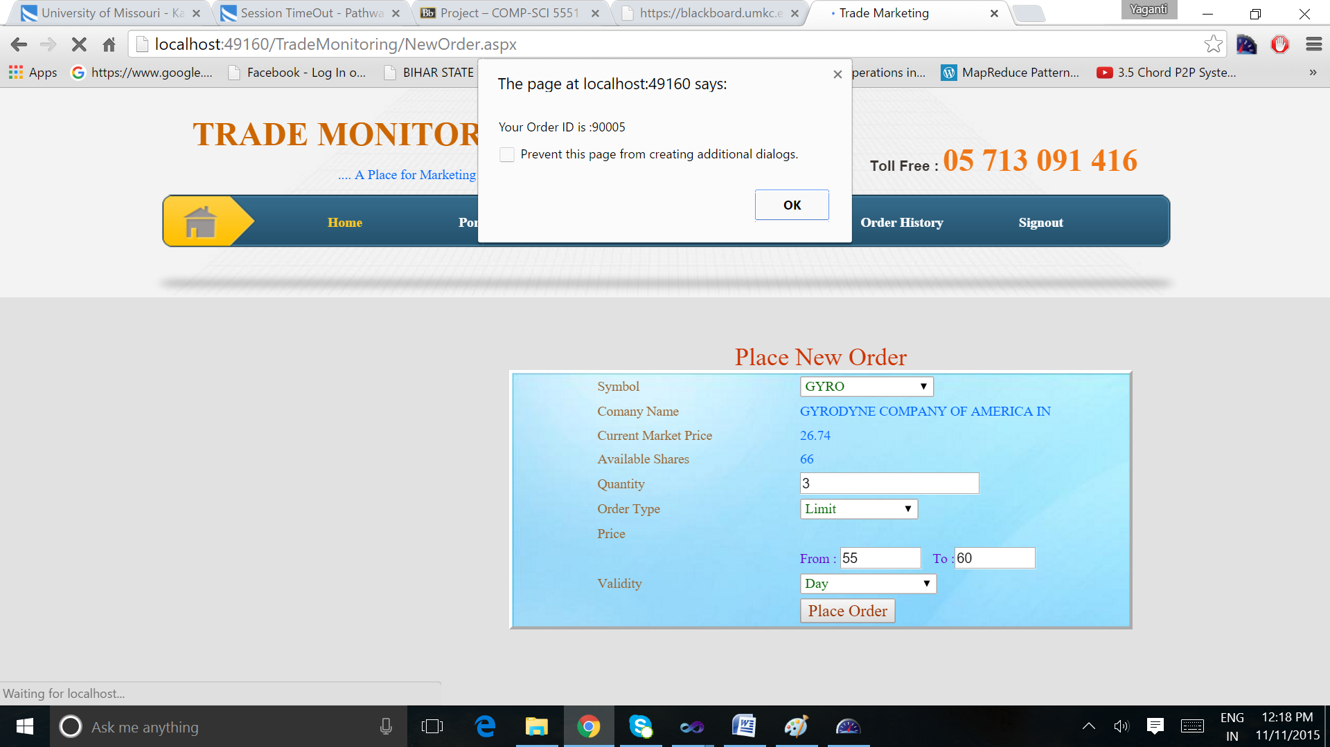
Placing the Order

Slide 9
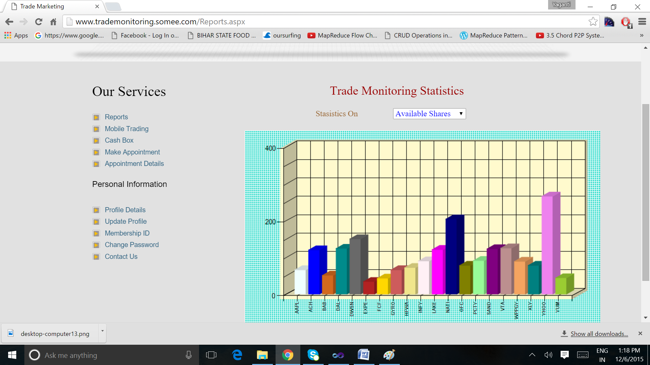
Shares Statistics

Slide 10
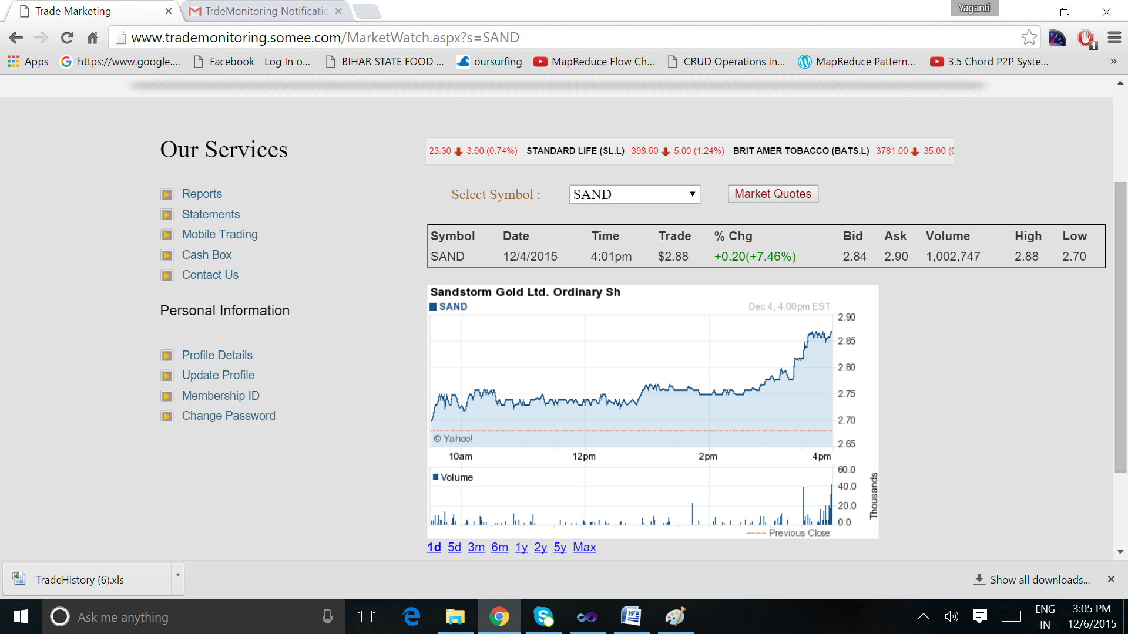
Market Statistics

Slide 11


